Slide 1

Prediction of Heart Stroke in Diabetic patients using Machine learning
S. kusalasri 20121A05P7
G. kalpana 21125A0507
C. Jignavi Reddy 19121A0532
S. Akram Hussian 20121A05Q1 20121A3211
G. Kalpana 20121A3227
32Kumar 20121A3254
Under the Guidance of
Mr. Ravindra Naik
Assistant Professor, CSE
Department of Computer Science and Engineering
SREE VIDYANIKETHAN ENGINEERING COLLEGE (Autonomous)
Sree Sainath Nagar, A. Rangampet, Tirupati – 517 102
2023-2024

Slide 2
Table of Contents
Abstract
Introduction
Problem Statement
Objectives
Literature Survey
Proposed System
Algorithm (or) Approach used
Dataset Description
Software and Hardware Requirements
Experimental Results and Discussion
Conclusions
References

Slide 3
ABSTRACT
Nowadays in the medical field,it is essential to predict diseases early to prevent them. Diabetes is one of the most chronic diseases all over the world. In today's lifestyles, sugar and fat are typically included in our dietary habits, which increases the risk of diabetes. Diabetes,a prevalent metabolic disorder, is a significant risk factor for cardiovascular complications, including strokes. Early detection and proactive management of stroke risk in diabetic patients can substantially improve their overall cardiovascular health and reduce the incidence of life-threatening events. Our project leverages machine learning algorithms such as Random Forest, Decision Tree and Light gradient boosting machine(LGBM) algorithms to analyze comprehensive datasets comprising medical history, lifestyle factors, and physiological parameters of diabetic individuals.The model integrates various features such as blood glucose levels, blood pressure, cholesterol levels, and demographic information. We also develops a user interface using streamlit library to predict whether the diabetic patient is prone to heart stroke or not. The outcomes of this project contribute to the growing field of predictive healthcare analytics, demonstrating the potential of machine learning in improving diagnostic accuracy and optimizing resource allocation in the healthcare sector.
Keywords: Diabetics, Heart stroke, DecisionTree Algorithm, Random Forest Agorithm, Light Gradient Boosting Machine.

Slide 4
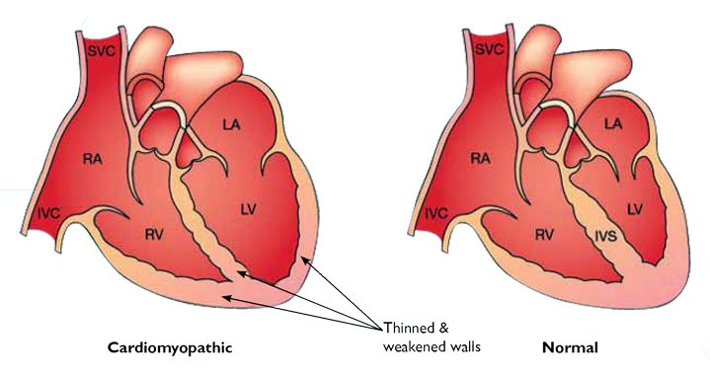
INTRODUCTION
Diabetic-Heart Disease
Diabetic heart disease is a term for heart disease in people who have diabetes.
If you have diabetes, you are much more likely to develop heart disease or have a stroke than people who don't have diabetes. And you may start having these problems at a younger age.
Research has shown that people with Type 2 diabetes are up to four times more likely than the general population to die from cardiovascular causes.
Although you say that you do not have heart disease today, diabetes can damage blood vessels and make the heart muscle stiffer. This eventually leads to problems with fluid retention and heart failure.
Heart condition in diabetic person and Normal person

Slide 5
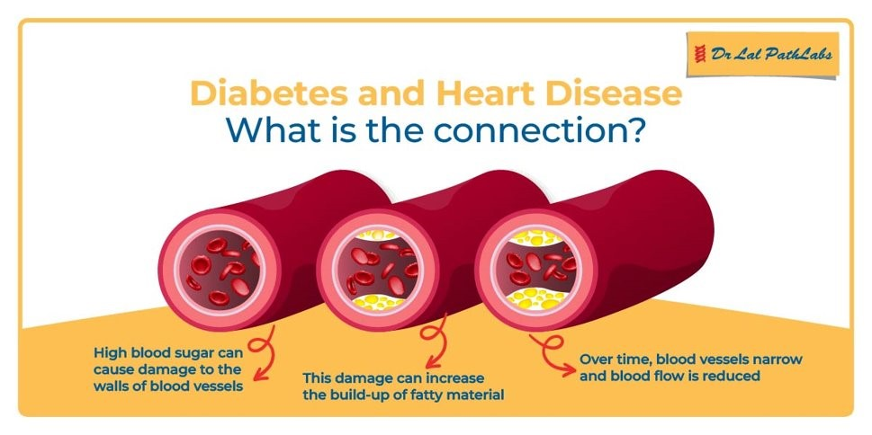
CONNECTION BETWEEN DIABETES AND HEART DISEASE

Slide 6
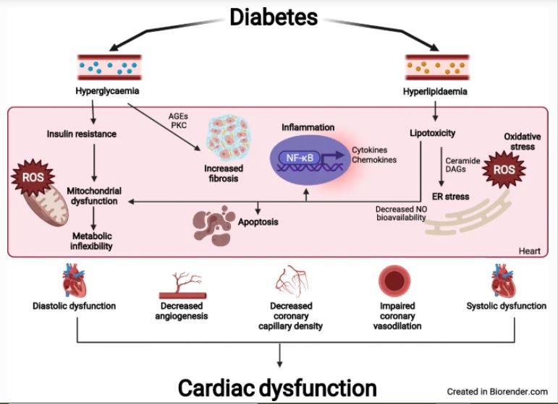
How Diabetics Causes Heart Disease?
Diabetes increases the risk of high blood pressure, narrowing of the arteries (atherosclerosis), coronary artery disease and stroke. So if you are a person with diabetes, you have a higher risk of developing heart disease and stroke.
High blood pressure is one of the most common risk factors for heart disease among people with diabetes.
It places strain on your heart and damages your blood vessels. This makes you more susceptible to a variety of complications including heart stroke and cardiovascular diseases.
Poorly managed levels of blood fats like cholesterol and triglycerides are common in people with diabetes. They can also increase the risk of developing heart disease.

Slide 7
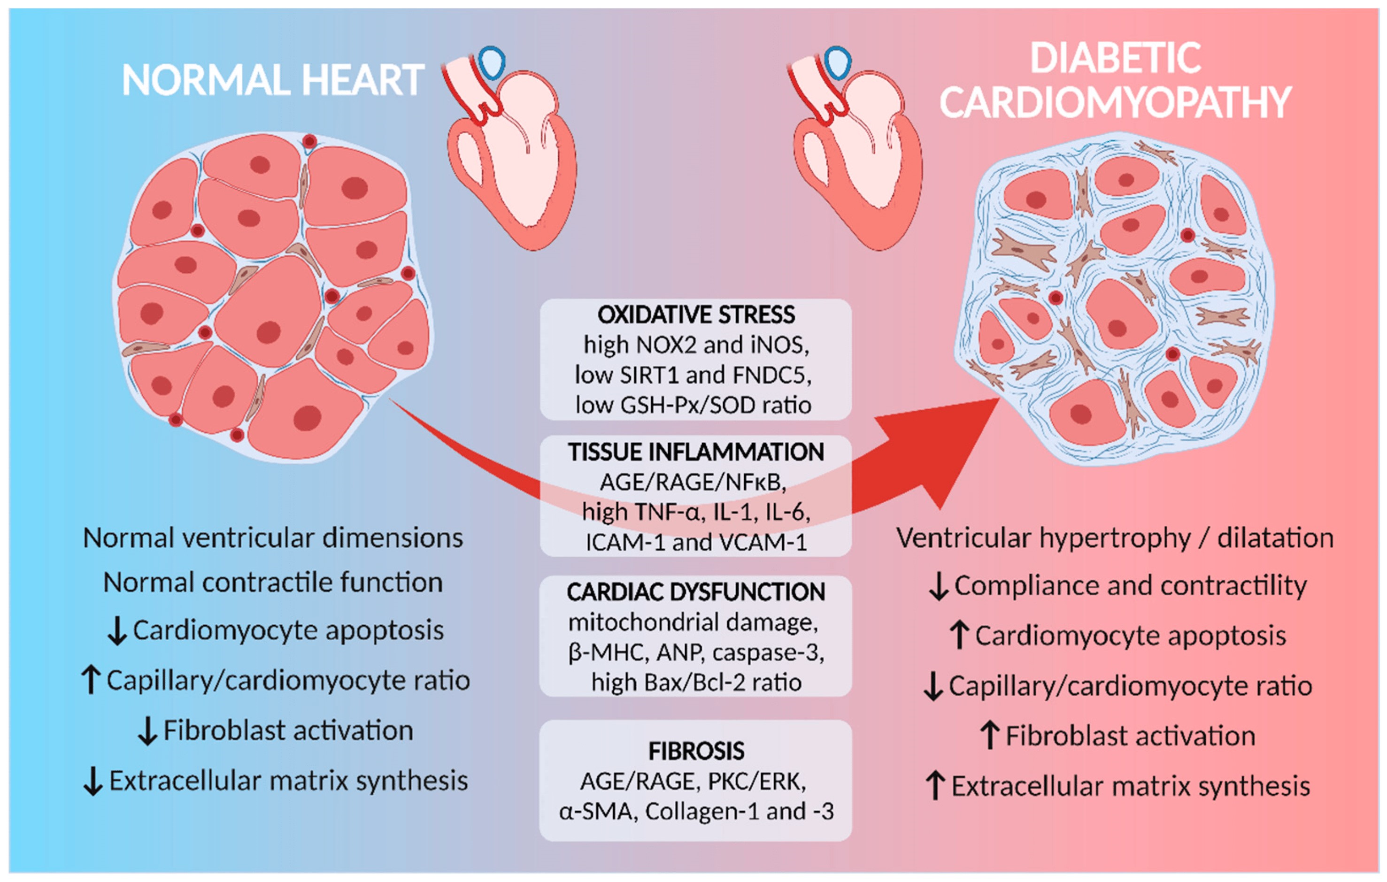
EFFECTS OF DIABETES ON HEART

Slide 8

PROBLEM STATEMENT
The task at hand is creating a precise and comprehensible predictive model for forecasting cardiac strokes in diabetes populations using machine learning algorithms, due to their capacity to identify intricate patterns within large datasets, presents a promising opportunity.And also using Streamlit library we develop the user interface web page to predict the chance of heart stroke in diabetic patient.

Slide 9
LITERATURE REVIEW
Author | Title | Methods used | Drawbacks
Sarra Samet et al. [1] | Diabetes mellitus early stage risk prediction using machine learning algorithms | Hybrid Machine Learning Model | Accuracy of the model is low.
Anandkumar K M et al. [2] | Cardiovascular Stroke Prediction System using Machine Learning Techniques | SVM, Multinomial Naive Bayes | High validation loss in the developed model
Sagarika Sil et al. [3] | Unleashing the Power of Machine Learning: Advancing the Early Prediction and Analysis of Diabetes Mellitus | Ensemble Machine learning model | The dataset lacks important features such as stroke

Slide 10
LITERATURE REVIEW
Author | Title | Methods used | Drawbacks
T. Adilakshmi et. al [4] | An Enhanced Machine Learning Technique to Predict Heart Disease | KNN ,Naive Bayes and Decision Tree | computational expensive and slow speed
Md. Imam Hossain et.al [5] | Heart disease prediction using distinct artificial intelligence techniques: performance analysis and comparison | Multilayer Perceptron (MLP) and SVM | The model produces false negatives and false positivies
Stacey Miertschin et. al [6] | A data-driven approach to predicting diabetes and cardiovascular disease with machine learning | Ensemble Machine Learning Model | performance should be improved

Slide 11
EXISTING SYSTEM
Decision Tree Approach
Decision Tree is a non-linear machine learning algorithm used for classification and regression.
It recursively splits the input space based on features to create a tree structure.
The splitting is done to maximize homogeneity in resulting subsets using metrics like Gini impurity or mean squared error.
The process continues until a stopping criterion is met, forming leaf nodes with class labels or predicted values.
Decision Trees are interpretable, handle mixed data types, but may require techniques like pruning to avoid overfitting.
LIMITATIONS:
Overfitting
High Variance

Slide 12
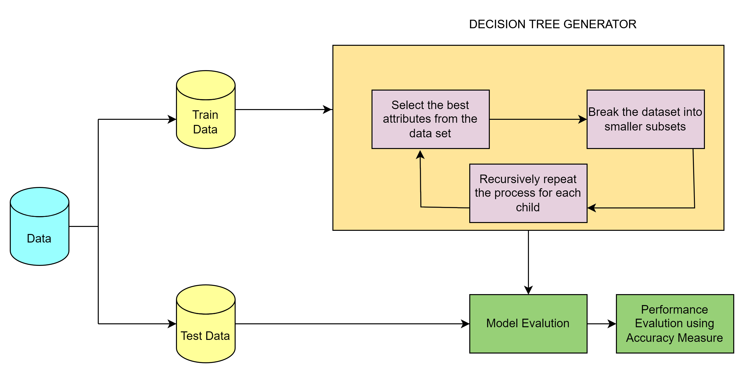
Decision Tree Algorithm

Slide 13
OBJECTIVES
The primary objective of this project is to develop a machine learning-based predictive model capable of accurately identifying diabetic patients at high risk of experiencing heart stroke.
To provide a reliable and effective solution for healthcare professionals to assess heart stroke risk in diabetic patients, enabling timely interventions and personalized care plans to prevent cardiovascular events.
To develop a user-friendly web interface using tools like Streamlit, allowing healthcare providers to easily input patient data and obtain personalized heart stroke risk predictions in a visually intuitive manner.

Slide 14
PROPOSED METHODOLOGY
Prediction of Heart Stroke in Diabetics involves techniques and methods to identify the risk of diabetic patient having Heart Disease. The algorithms used to predict Heart Stroke are:
1. Random Forest method
2. Light Gradient Boosting Machine Algorithm

Slide 15
Random Forest Approach
Random Forest operates on the principle of ensemble learning, where multiple weak learners are combined to create a strong learner.
Random Forest is a classifier that contains a number of decision trees on various subsets of the given dataset and takes the average to improve the predictive accuracy of that dataset.
Rather than depending on a single decision tree, the random forest forecasts the outcome based on the majority vote of projections from each tree. Because there are more trees in the forest, accuracy is higher and overfitting is avoided.
Accuracy of Random Forest- 95.12%
Advantages:
The major advantages of using Random forest algorithm are
Automatic variable selection
handles large datasets well

Slide 16
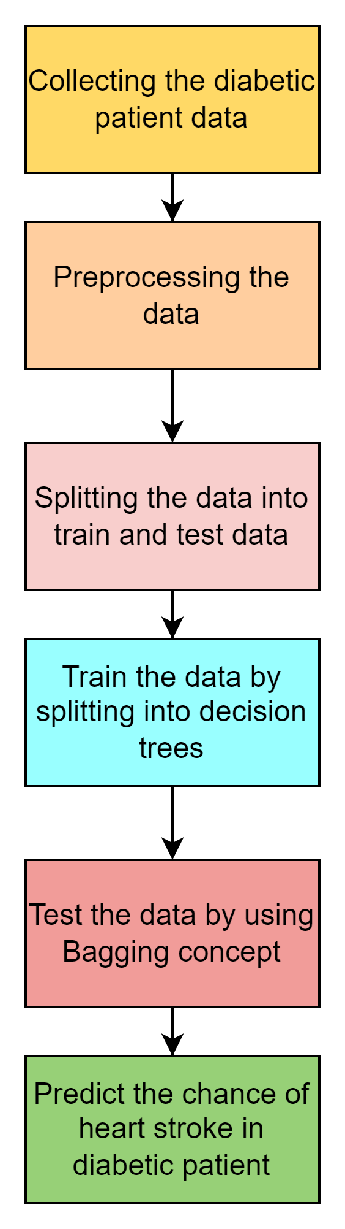
Random Forest Algorithm

Slide 17
Light Gradient Boosting Machine Approach
LightGBM, is a powerful gradient boosting framework that has gained popularity in machine learning and data science communities for its efficiency and effectiveness in handling large datasets.One of its primary advantages lies in its speed and scalability.
LGBM is notably faster than traditional gradient boosting implementations due to its novel techniques such as histogram-based algorithms for splitting trees and leaf-wise tree growth. This enables it to handle large datasets with millions of instances and features efficiently.
Moreover, LGBM provides flexibility through customizable hyperparameters, allowing practitioners to fine-tune the model according to specific requirements.
Accuracy of Light GBM-95.24%
Advantages:
LGBM stands out for its speed, scalability, accuracy, and memory efficiency, making it a preferred choice for various machine learning tasks.

Slide 18
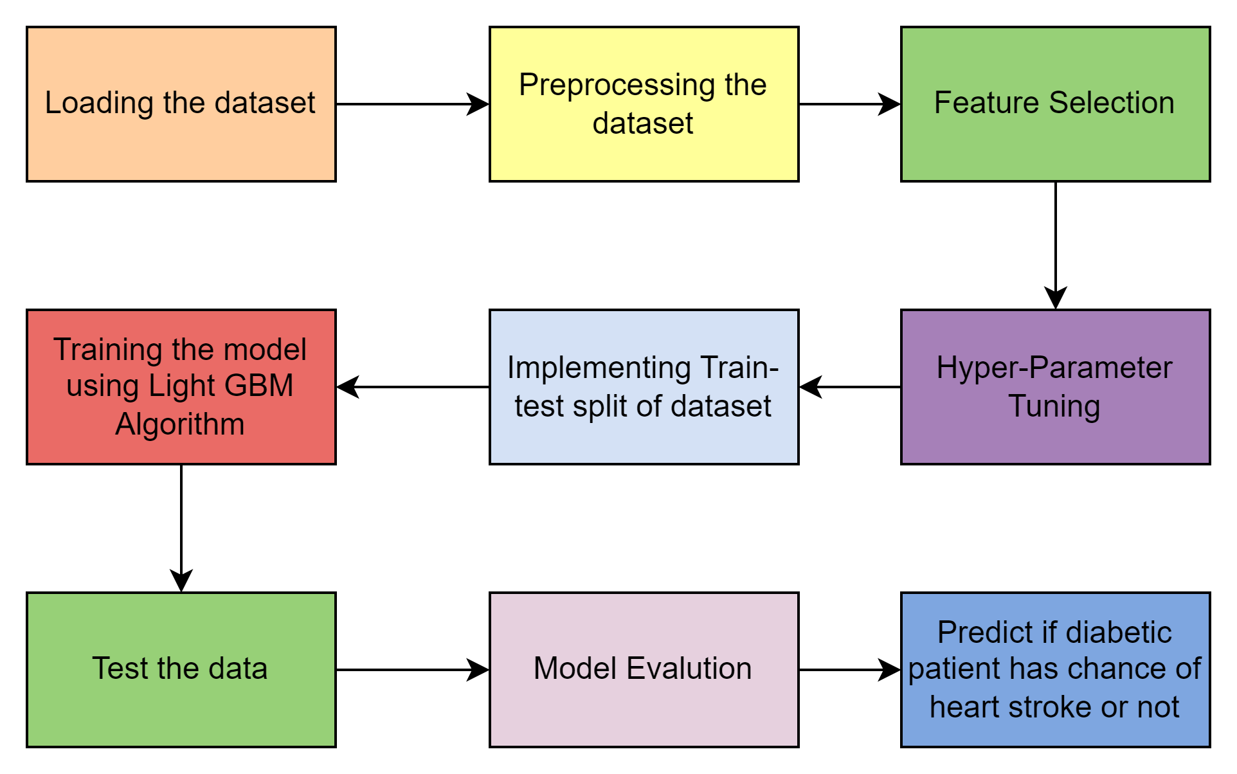
Light Gradient Boosting Machine Algorithm

Slide 19
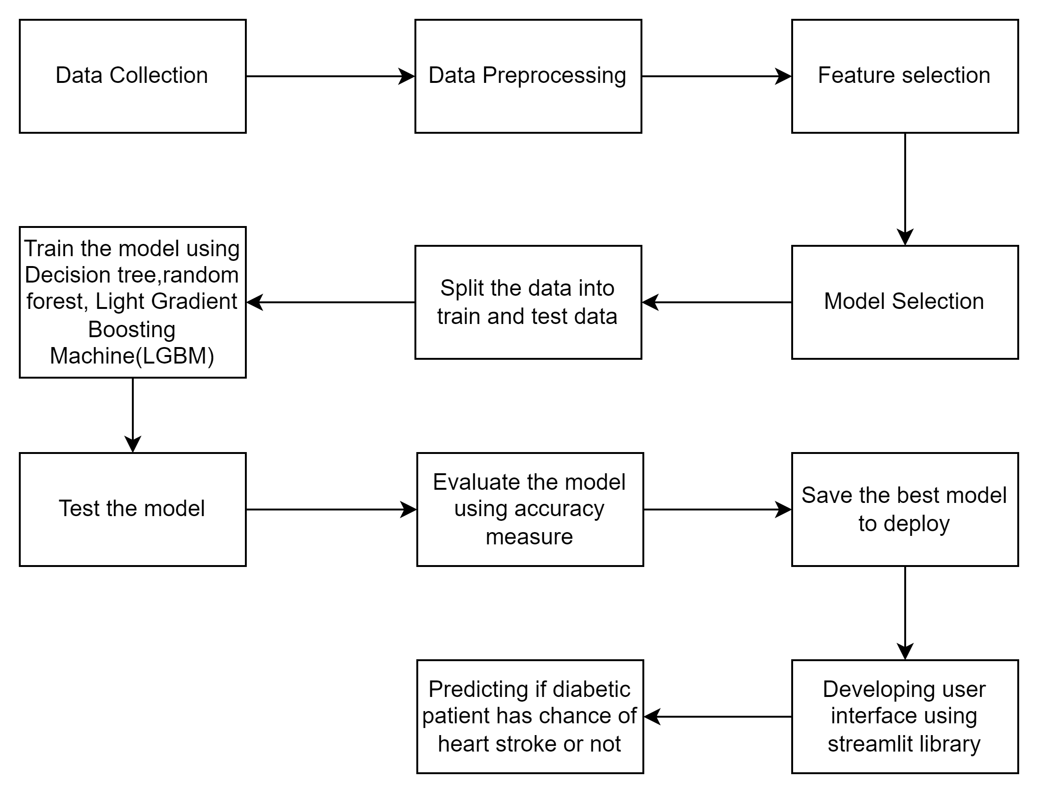
Architecture

Slide 20
RESULTS
In our project, we evaluate the performance of the machine learning algorithms such as decision tree, random forest and light Gradient Boosting Machine(LGBM) using accuracy measure.
SNO | Algorithm used | Accuracy Achieved
1 | Decision Tree | 93.82
2 | Random Forest | 95.16
3 | Light Gradient Boosting Machine(LGBM) | 95.24
Table : Performance Evaluation through Accuracy measure

Slide 21
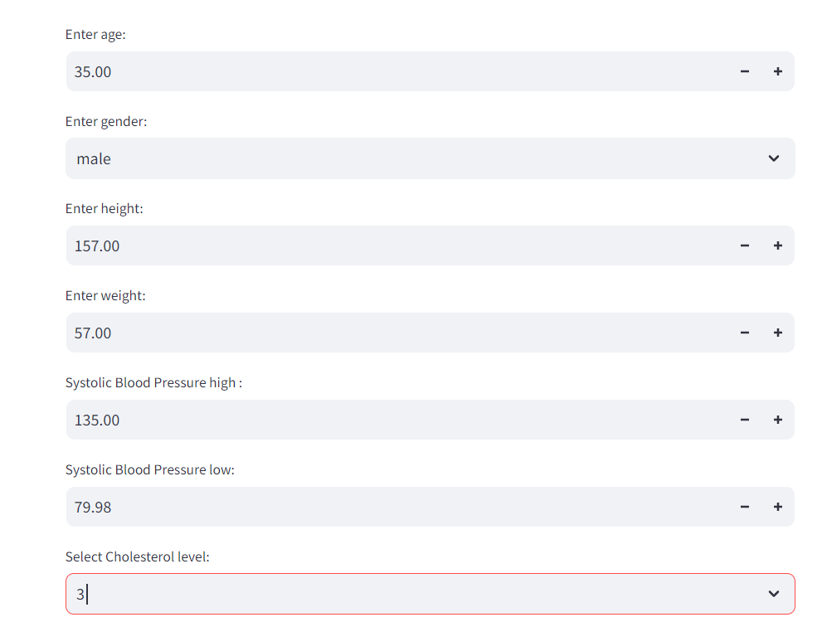
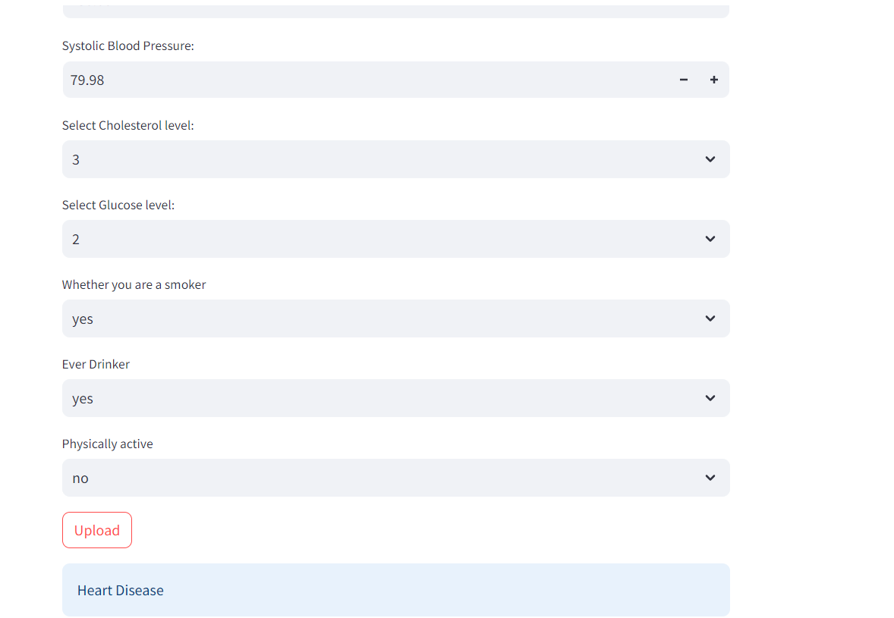
We have developed user-interface web page using streamlit library. In this we have to upload the patient data ,then it predicts whether the patient is vulnerable to heart stroke or not.

Slide 22
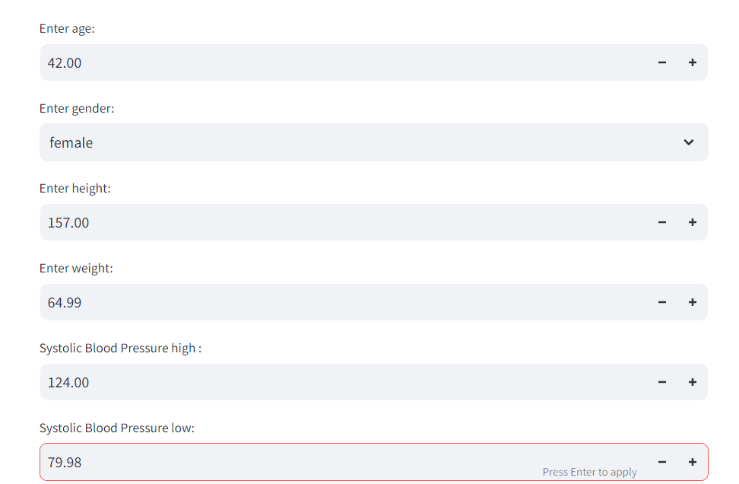
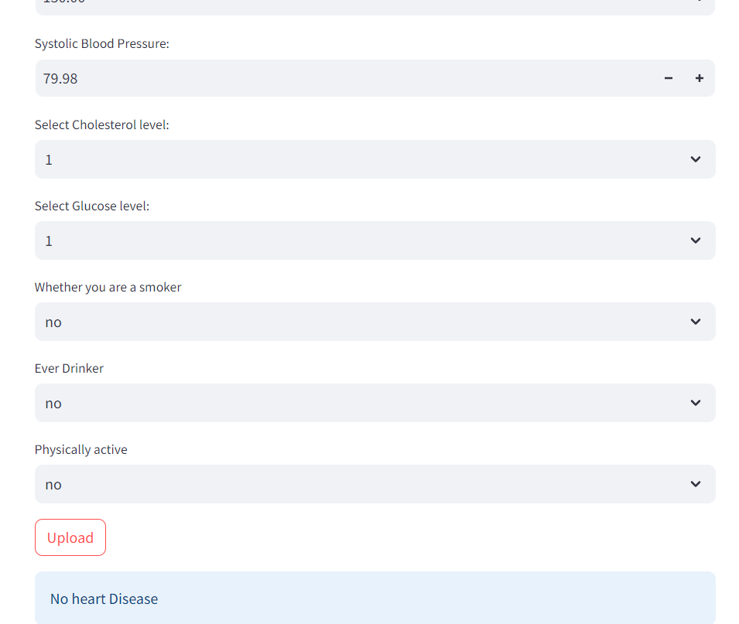

Slide 23
DATASET DESCRIPTION
This research utilizes a comprehensive dataset, for predicting heart strokes in individuals with diabetes plays a pivotal role in the development of the accurate and reliable predictive models. This dataset comprises a diverse array of essential information, encompassing demographic details, clinical measurements, and relevant medical histories.
Key features include age, gender, blood pressure, cholesterol levels, body mass index (BMI), glucose levels, smoking status,diabetics , previous heart stroke attack and familiar predispositions. The richness and breadth of this dataset enable machine learning algorithms to discern intricate patterns, contributing to a nuanced understanding of the complex interplay between diabetes and cardiovascular health.
To access the "Heart Stroke" dataset, follow this
“ https://datasetsearch.research.google.com/”

Slide 24
SOFTWARE AND HARDWARE REQUIREMENTS
SOFTWARE REQUIREMENTS:
Programming language – Python (Version-3.10.11)
Machine Learning Framework – Scikit Learn
Libraries – Pandas, Matplotlib, Streamlit
Development Environment – Google collabaratory and VSCode
HARDWARE REQUIREMENTS:
Processor – intel core i3 or above
Memory- Atleast 8GB RAM
Storage – 256 GB SSD or more
Stable Internet Connectivity

Slide 25
CONCLUSION AND FUTURE WORK
CONCLUSION :
In our project, the utilization of the machine learning algorithms and the analysis of relevant medical data, we were able to develop a predictive model that demonstrates promising accuracy in forecasting heart stroke occurrences among diabetic individuals.
Additionally, the integration of the Streamlit library facilitated the creation of a user-friendly web interface, enhancing accessibility and usability for both healthcare professionals and patients.
This project underscores the potential of machine learning in healthcare applications, offering a valuable tool for early detection and prevention of cardiovascular complications in diabetic populations.

Slide 26
FUTURE SCOPE :
Integrating data from IoT devices and wearable sensors, such as continuous glucose monitors or fitness trackers, could provide real-time physiological data for more accurate and personalized predictions. This would require the development of robust data processing pipelines and integration frameworks.
Exaplainable AI(XAI): Incorporating techniques for explainable AI could enhance the interpretability of the predictive model, providing insights into the factors driving the predictions and facilitating trust and acceptance among healthcare professionals and patients.
Integrating the predictive model into telemedicine platforms and remote monitoring systems could enable proactive interventions and personalized care for diabetic patients at risk of heart stroke. This would involve the integration of real-time prediction capabilities into existing healthcare IT infrastructure.

Slide 27
REFERENCES
[1] Diabetes mellitus early stage risk prediction using machine learning algorithms DOI: 10.1109/ICNAS53565.2021.9628955
[2] D. Sisodia and D. S. Sisodia, ‘Prediction of diabetes using classification algorithms’, Procedia computer science, vol. 132, pp.1578–1585, 2018
[3] Q. Wang, W. Cao, J. Guo, J. Ren, Y. Cheng, and D. N. Davis, “DMP_MI: An effective diabetes mellitus classification algorithm on imbalanced data with missing values,” IEEE Access, vol. 7, pp. 102232–102238, 2019, doi: 10.1109/ACCESS.2019.2929866.
[4] N. Sneha and T. Gangil, “Analysis of diabetes mellitus for early prediction using optimal features selection,” J. Big Data, vol. 6, no. 1, 2019, doi: 10.1186/s40537-019-0175-6.
[5] M. Rout and A. Kaur, “Prediction of Diabetes Risk based on Machine Learning Techniques,” Proc. Int. Conf. Intell. Eng. Manag. ICIEM 2020, pp. 246–251, 2020, doi: 10.1109/ICIEM48762.2020.9160276.
[6] H. Kaur and V. Kumari, “Predictive modelling and analytics for diabetes using a machine learning approach,” Appl. Comput. Informatics, 2019, doi: 10.1016/j.aci.2018.12.004.
[7] Aishwarya R., Gayathri P., N. Jaisankar., 2013. A Method for Classification Using Machine Learning Technique for Diabetes, International Journal of Engineering and Technology (IJET) ,Vol 5 No 3.

